Slide 1
BIT second semester
Hemanta Rai
Assistant Professor
Patan Multiple Campus
T.U.

Slide 2
Unit 7 National Income Accounting
Concept of macroeconomics and its scope, Meaning of national income: Various concepts of NI: GDP, NDP, GNP and NNP (both in – market price and factor cost terms), Nominal GDP, Real GDP and GDP deflator, Potential and actual GDP, Personal income, Disposable income and Saving, Per-capita income. Three approaches of measurement of NI (Product, Income and Expenditure), Measurement Difficulties of NI. Numerical assignments and Case studies

Slide 3
Meaning of macroeconomics
it is a branch of economics that deals with the economics system as a whole.
It explain aggregate economic variables and their interrelationships.
These aggregate variables consist total output, total income, employment rate, total consumption, total investment, rate of inflation, economic growth rate of country,
Thus it is also called the study of big lump, study of average, looking through birds (Eagles) eye view.
It is also known as the policy economics.
It is known as income theory because almost all macroeconomic variables revolve around the national income.

Slide 4
Contd…
Macroeconomics is the study of behaviour of the economy as a whole. It examine the overall level of national output, employment, price and foreign trade “P.A. Samuelson”
Macroeconomics deals not with individual quantities but with aggregate of these quantities, not with individual income but with national income, not with individual price but with price level, not with individual output but with national output. ‘K.E. Boulding’
In short, macroeconomics is concerned with the process of income and employment determination and also determinants of income and employment. Hence it is also called income employment theory.

Slide 5
Scope of macroeconomics
Theory of income and employment
Theory of consumption
Theory of investment
Macro theory of distribution
Theories of international trade and business fluctuations
Theory of money and price level
Theory of economics growth
Macroeconomic policies

Slide 6
Some basic concepts in macroeconomics
Potential GDP/GNP and Actual GDP/GNP:
Potential GDP/GNP is an estimate of what the economy could produce at high rates of utilization of our available resources, i.e. land, labour, capita etc. especially full employment level of labour. It is also referred as potential income or full employment income.
Actual GDP/GNP represents what the economy does, in fact, produce at maximum utilization of available resources.
The difference/ gap between potential GDP/GNP and actual GDP/GNP is called GDP/GNP gap.

Slide 7
Contd………..
Transfer payments:
All types of payments received by households, production units and non-profit making units from government, business sector and other sources without rendering any services are known as transfer payment, social security benefits, unemployment allowance, old age pensions, interest on public debt, scholarship, gift, prizes charity funds are the example of transfer payment. These payments must be excluded while calculating domestic or national product in terms of both market price and factor cost. But the must be added with personal income because they are actually received by individuals or household,

Slide 8
Contd………… capital gains:
These are the income obtained from the transactions of financial instruments such as shares, bonds, treasury bills, etc. they must be excluded from domestic or national product.
Second-hand sales:
The expenditures on second-hand goods should not be included while calculating domestic or national product. It is because these values do not contribute to the current year’s production of goods and services
Illegal income:
Income from illegal activities such as gambling smuggling, robbery, etc are called illegal income. They must be excluded while calculating GDP/GNP because they do not add productive capacity of the economy

Slide 9
Stock and flows variables:
Stock means that quantity of economic variable, which is measured at a particular point of time, while flow is measured during a period of time.
Depreciation:
It is define as the loss in the value of fixed capital assets due to normal wear and tear and foreseen obsolescence. It is also known as capital consumption allowance
Production process
It is the integration of land, labour, capital, and enterprise for the purpose of producing goods and services,

Slide 10
Contd…..
Economic (or productive) sectors:
Primary sector: which includes agro-products (food, cash crops, animal husbandry, horticulture etc.) fishery, forestry, mining, querying and so on.
Secondary sector: which includes manufacturing, construction, electricity, gas, water supply and others.
Tertiary sector: which includes all types of nursing business like banking and insurance, transport and communication, trade and commerce, health, education and other services

Slide 11
Consumer and producer goods:
The goods and services which are consumed by the people to directly satisfy their wants are called consumer goods. On the other hand those goods which are used to produce other goods are known as producer goods, those goods are also known as the capital goods.
Intermediate and final products:
Intermediate goods are those goods which are sold by one firm to another for resale or for further processing or value addition. On other hand the products which are sold finally to the consumer or investor are the final products.

Slide 12
Factor cost and market price
Factor cost is the total sum of all earning received by factors of production in terms of compensation of employees, rent, profit, interest etc. on the other hand, market price of the total monetary value of final goods and services.
Market price = factor cost + net indirect taxes or
Factor cost = market price – net indirect taxes, And
net indirect taxes = indirect taxes – subsidies

Slide 13
Circular flow of income and expenditure
Economy is an integrated activity for the production, distribution/exchange and consumption. In performing these activities, people are involved in making transactions they buy and sell goods and services.
Economic transactions generate two kinds of flows i) real flow the flow of goods and services and ii) money flow
Product and money flow in the opposite direction.
Circular flow of income and expenditure is the integrated flow of resources and goods and services among the different sectors of the economy.
This concept is actually abstract and complex in the reality.

Slide 14
Contd……
Real flow of income implies the flow of factor services from the household sector to the producing sector and the corresponding flow of goods and services from the producing sector to the household sector.
Money flow refers to the flow of factor income viz. rent interest, wage and profit from the producing sector to household sector as monetary rewards for their factor service. They household spend their incomes on goods and services produced by the producing sector.
To explain circular flow of income and expenditure we make following three models:
Circular flow of income and expenditure in two sector economy.
Circular flow of income and expenditure in three sector economy.
Circular flow of income and expenditure in four sector economy.

Slide 15
Circular flow of income and expenditure in two sector economy.
Two sector economy consist of household and business sectors.
This is obviously an unrealistic model because such kind of economy is not found in the real world
This model is known as closed economy
Assumptions
There are only two sectors in the economy, a)households and b)business/producers.
All income is spent on consumption. There are no saving in the economy.
There is no government and no international trade.
Household are the owners of factors of production, they are the suppliers of factors services
Producers/firms hire factor services from the household

Slide 16
The households are assumed to possess certain specific feature
The households are the owner of all factors of production
Their total income consists of wages, rent, interest and profit
They are the consumers of all consumer goods and services
They save a part of their income and supply finance to the firms
The business firms have the following features
They own no resources of their own
They hire and use the factors of production from the households
They produce and sell goods and services to the households
They do not save, there is no corporate savings.

Slide 17
Circular flow of income and expenditure in two sector economy.
Banks and financial intermediaries
(Wage, interest, rent, profit)
(Factor services of land, labor, capital and, entrepreneurial ability)
Business sector
(Goods and services)
(Money expenditure for goods and service)
Household sector
saving
investment

Slide 18
Circular flow of income and expenditure in three sector economy.
three sector consist of household, business and government sector.
It is also known as three sector closed economy.
It is more realistic than two sector economy as it includes government sector which plays important role in the economy.
Assumptions
The economy consist of household, business and government sector
There is government intervention
Government imposes taxes and grants subsidies
The economy has no international trade
Business sector pay both direct and indirect tax to the government
Household sector pays only direct tax to the government

Slide 19
Circular flow of income and expenditure in three sector economy.
Government sector
(Wage, interest, rent, profit)
(Factor services of land, labor, capital and, entrepreneurial ability)
Business sector
(Goods and services)
(Money expenditure for goods and service)
Household sector
Indirect taxes and
Direct taxes
Wages, salaries
And transfer payments
Direct taxes
Government Purchases
and subsidies
Banks and financial
intermediaries
Saving
investment

Slide 20
Circular flow of income and expenditure in four sector economy.
Four sector economy consists of household sector, business sector, government sector and foreign sector or rest of the world.
It is also known as the open economy.
This model is formed by adding foreign sector to the three sector model
Assumptions
There are four sector in the economy which includes household, business, government and foreign sectors
There is no restriction on import and export
There is minimum government intervention
There is well manage financial market
Household export only labour and capital
Business firms export and import only goods and services

Slide 21
Circular flow of income and expenditure in Four sector economy.
Financial intermediaries
government
Business sector
Foreign countries
Household sector
Wages, salaries
And transfer payments
Net tax payments
Net tax payments
Government Purchases
and subsidies
Factors of production
Wages, rent, interest, profit
saving
investment
Consumption expenditure
Goods and services
Foreign remittance
Payments for imports (M)
Export of capital and manpower
Receipts from exports (X)

Slide 22
Definition of national income
It is defined as the net income generated from all productive sectors in a country for a specified period of time.
It refers to the sum of income earned by all individuals of a nation in a particular period of time.
It represents as a receipt total, an expenditure total and the total volume of production.
National income data reveal the total economic performance of the economy as a whole.

Slide 23
Marshall’s definition: “The labour and capital of a country acting upon its natural resources produce a certain net aggregate of commodities, material and immaterial including services of all kinds. This is the net annual income or revenue of a country or the national dividend”
A.C. Pigou “National income is that part of objective income of the community, including of course income derived from abroad, which can be measured in money”
Fisher “The national dividend or income consists solely of services as received by ultimate consumers, whether from their material or from human environments”
Simon Kuznet “National income is the net output of commodities and services following during the year from the country’s productive system in the hand of the ultimate consumers”

Slide 24
The United Nation has defined national income in three ways:
Net national product i.e. aggregate of net value added in all economic (or productive) sectors during a specified period, including net income from abroad.
Sum of the distributive shares, i.e. the aggregate of national income accrued for the factors of production (in the form of wages, profits, interest, rent, ect.) in a specific period.
Net national expenditure, i.e. the aggregate expenditure on final consumption of goods and services, plus domestic and foreign investment.

Slide 25
Based in the above definitions, the main features of national income are
It is an outcome of combine contribution of all economic resources like natural i.e. Land, human i.e. labour and entrepreneurship and physical i.e. capital
it is the net amount of income accruing from all economic activities like primary (agriculture), secondary (industry) and tertiary (trade, transport, service) sector for a specified period of time, usually a year within a country plus net factor income from abroad
It is also defined as a flow of final goods and services produced from all economic sectors in a country for a specified period of time usually a year. Hence it is flow concept.
There is triple identity;
National output=National Income=National Expenditure

Slide 26
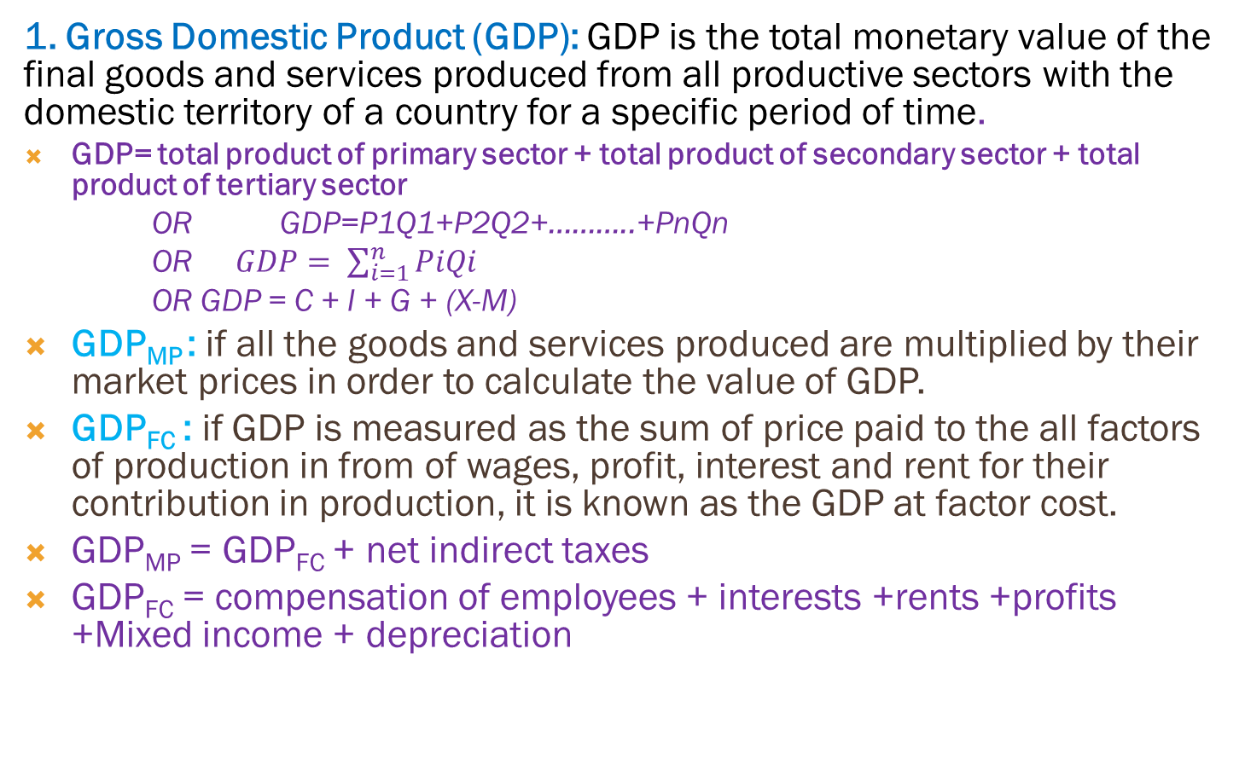
Various concepts of national income
1. Gross Domestic Product (GDP): GDP is the total monetary value of the final goods and services produced from all productive sectors with the domestic territory of a country for a specific period of time.
GDP= total product of primary sector + total product of secondary sector + total product of tertiary sector
OR GDP=P1Q1+P2Q2+………..+PnQn
OR$GDP= \sum_{i=1}^{n}{PiQi}$
OR GDP = C + I + G + (X-M)
GDP_{MP} : if all the goods and services produced are multiplied by their market prices in order to calculate the value of GDP.
GDP_{FC} : if GDP is measured as the sum of price paid to the all factors of production in from of wages, profit, interest and rent for their contribution in production, it is known as the GDP at factor cost.
GDP_{MP} = GDP_{FC} + net indirect taxes
GDP_{FC} = compensation of employees + interests +rents +profits +Mixed income + depreciation

Slide 27
2. (NDP) Net Domestic product:
GDP minus depreciation is called net domestic product. In other words it is the estimate of net monetary value of final goods and services produced within a country for a specified period of time.
NDP=GDP – Depreciation
IF NDP is measured at actual market price is called (NDP_{MP)} where as NDP measured as the sum of price paid to the all factors of production in the from of wages and salaries, profit, interest and rent for their contribution in the production of goods and services is called NDP at factor cost (NDP_{FC} )
NDP_{FC} = NDP_{MP} – Net indirect taxes
NDP_{FC} = GDP_{FC}– depreciation
NDP_{FC} = compensation of employees + interests +rents +profits +Mixed income
Net indirect Taxes = Indirect taxes - subsidies

Slide 28
3. Gross national product (GNP):
it the total value of all final goods and services produced during a specified period of time by domestically owned resources or factors of production. In other words, it is the value of all final goods and services produced within a country in year plus net factor income from abroad.
GNP_{Mp} = GDP_{MP} + Net income from abroad (NFIA) (R-P)
GNP_{Mp} = C + I + G + (X-M) + (NFIA)
GNP_{FC} = GNP_{MP} – net indirect taxes
GNP_{FC} = compensation of employees + interests +rents +profits +Mixed income + depreciation + (NFIA)
4. Net National product (NNP) :
it is the value of all final goods and service produced during a year by domestically owned factors of production after allowing for depreciation
NNP_{Mp} = GNP_{MP} – depreciation
NNP_{FC} = NNP_{MP} – Net indirect taxes
NNP_{Mp} = NDP_{MP} + Net income from abroad (NFIA)
NNP_{FC} = NDP_{FC} + Net income from abroad (NFIA)
NNP_{FC} = compensation of employees + interests +rents +profits +Mixed income + (NFIA)

Slide 29
5. National income (NI) or NNP_{FC}
It is defined as the net income evaluated in term of earning of factors of production through participation in the production process such as compensation of employees, interests, rents, profits etc.
NNP_{FC} = compensation of employees + interests +rents +profits +Mixed income + (NFIA)
6. Personal Income:
it is the total income earned by the households or individuals of a country from all possible productive sources plus transfer payments before paying direct taxes in year. In other words it is sum of all incomes actually received by individuals and households of a country during a year.

Slide 30
Contd…
to calculate personal income from NI there is needed following adjustment.
Corporate profit minus dividends ( or corporate profit taxes and undistributed profit: some corporate profits are paid to the households in the form of dividend are part of (PI). The profits that remains after paid dividends are not paid to households, so corporate profit taxes and undistributed profit must be subtracted from NI when computing PI.
Social security (insurance) payments: these are the payments made to the government or insurance companies, some by firms and some by employees. Because these payments are not received by individuals or households, they must be subtracted from NI when computing PI
Transfer payments all types of transfer payments must be added in NI while calculating PI.
PI= NI – (undistributed profit + corporate profit taxes + social security contribution - transfer payments)

Slide 31
Disposable income (DI):
It is that part of the personal income which the individuals or households of a country can spend the way they like. It is obtained by deducting the direct taxes or personal taxes from personal income.
DI (Yd) = PI – direct taxes further
DI (Yd) = C + S OR DI=C+I
Saving :
It is defined as the excess of disposable income over consumption expenditure. “Current saving is the difference between current income and current consumption” Keynes
S= DI (Yd) – C

Slide 32
Per Capita income:
It is the average income of the people of a country in a particular year. It is the national income divided by the total population of a country for respective years.
Per capita income (2020) = (National Income 2020)/(Total population 2020)
Real GDP, Nominal GDP, GDP Deflator:
Nominal GDP is the total monetary value of final goods and services in terms of current market prices produced from all productive sectors within a country during a year. In other words it is GDP at market price which measures the total spending on final goods and services within a country during a year.
Thus nominal GDP = P1Q1+P2Q2+………..+PnQn
If GNP_{MP} rises from one year to the next, one of two things must be true 1) the economy is producing a larger output of goods and services, or 2) goods and services being sold at higher prices. Economist want to separate these two effects while they study changes in economy over time. They want a measure of the total quantity of product the economy is producing that is not affected by the changes in the prices,

Slide 33
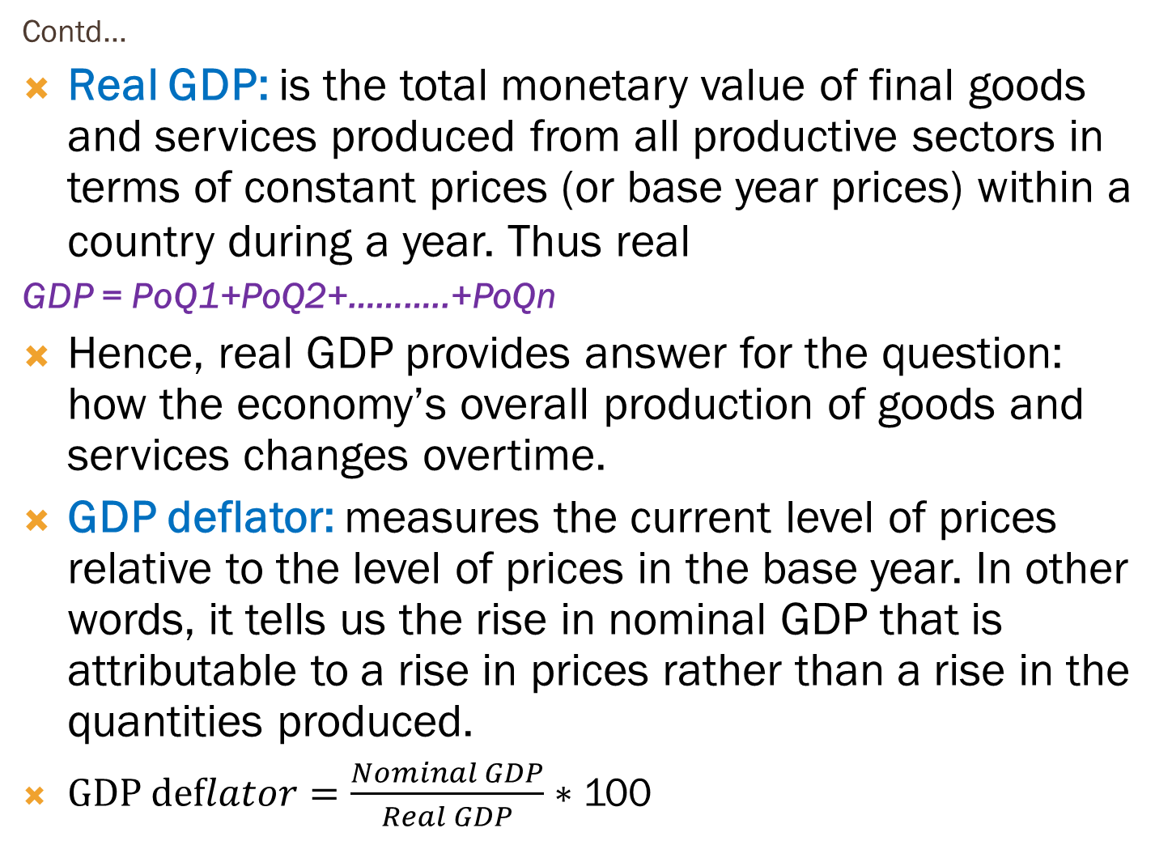
Contd…
Real GDP: is the total monetary value of final goods and services produced from all productive sectors in terms of constant prices (or base year prices) within a country during a year. Thus real
GDP = PoQ1+PoQ2+………..+PoQn
Hence, real GDP provides answer for the question: how the economy’s overall production of goods and services changes overtime.
GDP deflator: measures the current level of prices relative to the level of prices in the base year. In other words, it tells us the rise in nominal GDP that is attributable to a rise in prices rather than a rise in the quantities produced.
$GDP deflator=\frac{Nominal GDP}{Real GDP}∗$ 100

Slide 34

Rate of inflation: on the basis of GDP deflator, rate of inflation between any two period of time can be measured as
$Rate of inflation(r)=\frac{Change in GDP deflator}{GDP deflator for previous year}∗$ 100
Year | Px | Qx | Py | Qy
2015 | 10 | 1000 | 20 | 500
2016 | 20 | 1500 | 30 | 1000
2017 | 30 | 2000 | 40 | 1500

Slide 35
Year | Px | Qx | Py | Qy
2015 | Rs10 | 1000 | RS20 | 500
2016 | Rs20 | 1500 | Rs30 | 1000
2017 | Rs30 | 2000 | Rs40 | 1500
Year | Computation of nominal GDP
2015 | 10*1000+20*500 = Rs.20000
2016 | 20*1500+30*1000 = Rs.60000
2017 | 30*2000+40*1500 = Rs.120000
Year | computation of Real GDP (Base Year 2015)
2015 | 10*1000+20*500 = Rs.20000
2016 | 10*1500+20*1000 =Rs.35000
2017 | 10*2000+20*1500 =Rs.50000
Year | computation of GDP Deflator
2015 | (20000/20000) *100 = 100
2016 | (60000/35000) * 100 = 171
2017 | (120000/50000) * 100 = 240
Year | computation of Rate of inflation
2015 | -
2016 | (171 – 100)/100 *100 = 71%
2017 | (240 – 171)/171 *100 = 40%

Slide 36
Questions:
1 In the year 2015, the economy produces 2000 loaves of bread that sell for Rs 40 each. In the year 2016, the economy produces 4000 loaves of bread that sell for Rs 45 each.
calculate nominal GDP, real GDP and the GDP deflator for each year (use 2015 as the base year).
By what percentage does each of these three statistics rise from one year to the next?
State the significance of real GDP in economic analysis.
2. consider the following data on GDP of hypothetical economy.
What is the growth rate of nominal income between 2015 and 2016?
What is the growth rate of GDP deflator between 2015 and 2016?
What is the real income in 2015 measured in price of 2013?
What is the real income in 2016 measured in price of 2013?
Year | Nominal GDP (in billions) | GDP deflator (Base year 2013
2015 | 20000 | 118
2016 | 33333 | 125

Slide 37
Measurement method of national income /methods of measuring national income
1. Expenditure method (or spending approach):
It measures the GDP_{MP} by taking the sum of expenditure made households, firms and government on final goods and services in an economy during an accounting period.
Total income generated in the economy can be spent either on consumer goods or investment goods. Thus
We can get GDP by summing up all consumption expenditure and investment expenditure made by all individuals or households, firms government and net foreign investment within a country.
GDP_{MP} = C+I+G+(X – M)
GNP_{MP} = C+I+G+ (X – M) + (R – P) NFIA
NNP_{MP} = C+I+G+(X – M) + (R – P) – depreciation
NNP_{FC} (national income) = C+I+G+(X – M) + (R – P) – depreciation – (net indirect taxes)

Slide 38
Components of expenditure method:
1. Personal consumption expenditure (C):
All the expenses on durable goods like watch, furniture, vehicle etc. (but not residential houses, which are classified under investment)
All the expenditure on no-durable goods like, milk, rice, clothes etc. and
All expenditures incurred on services of all kinds like fees paid to doctors and lawyers, and bills paid for transportation and communication, etc.
2. Gross private domestic investment (I):
Non-residential investment: investment on machines, tools, plants, vehicles, furnitures etc.
Residential investment: expenditures made on factories, warehouses, business complex, office buildings and on new houses apartments

Slide 39
Changes in business inventories: it is the difference between closing stock and opening stock. It can be looked at as goods which firms now produce and intend to sell later
Depreciation: it is the value of the capital that wears out during the period over which economic activity is being measured.
It may also be classified as
I =net fixed investment (or net fixed capital formation) + changes in inventories + depreciation
I = net investment (net capital formation) + depreciation
I = Gross fixed investment + changes in inventories
I = gross fixed capital formation + changes in inventories

Slide 40
3. Government expenditure (G):
Expenditure made by the government (central, state or local) on final goods and services, including those produced abroad are part of GDE (GDP).
The expenditures on obligatory functions eg security, administrative, etc and optional functions (or socio-economic infrastructures) are added but spending on transfer payments are not included.
4. Net Export or net foreign investment (X-M):
It is the difference between all expenditures made by foreign residence on domestic goods and services and all expenditures made by our residents on foreign goods and services.
It is the difference between export earnings and import expenses. Imported goods are not produced within the country and hence cannot be included in GDP, but exported goods are produced within country and hence should be included in GDP.

Slide 41
5. Net factor income from abroad (NFIA) or NET receipts (R-P):
It is the difference between the factor income received from abroad by normal residents of Nepal for rendering factor services in other countries and the factor payments to the foreign residents for their factor services within the domestic territory on Nepal.
Net factor income earned from abroad has the following three components
Net compensation of employees
Net income from property
Net retained earnings of the resident companies working foreign countries
While estimating national income by expenditure method following economic values should be excluded
All expenses incurred in second-hand goods.
All expenditures incurred on financial assets, like shares and bonds within the country
All government expenditure on transfer payment
All expenses incurred on all intermediate goods and services.

Slide 42
Example: consider the following data for national income accounts and calculate GNP_{MP} and NNP_{FC}.
Net factor income from abroad Rs in crores (-10)
Net exports (-14)
Net indirect taxes 94
Net change in stock 26
Private final consumption expenditure 530
Government’s final expenditure 100
Consumption of fixed capital 90
Gross fixed domestic capital formation 200
Solution
Since GNP_{MP} =C+I+G+(X-M)+NFIA
GNP_{MP} = 530+226+100+(-14)+(-10) =832
b. NNP_{FC} = NNP_{MP} – net indirect taxes
NNP_{MP} = GNP_{MP} – depreciation (consumption of fixed capital)
NNP_{MP} = 832 – 90 =742
NNP_{FC} = 742 – 94 =648

Slide 43
Calculate net national product at factor cost from the following data
GDP =
Items | Rs (in crorers)
Private final consumption expenditure | 580
Government expenditure | 100
Subsidies | 40
Gross domestic fixed capital formation | 210
Indirect taxes | 140
Depreciation | 90
Net factor income from abroad | (-10)
Net addition in stock | 30
Net exports | (-10)

Slide 44
2. Income method (or share distributive approach):
In this method, GDP_{FC} is measured by taking the sum of all factor incomes generated from all productive sectors as a form of compensation of employees, rent, interest, profits etc. within the domestic territory of the country for specified period of time.
GNP_{FC} is calculated by taking the sum of GDP_{FC} and net factor income from abroad.
By depreciation from GNP_{FC}, NNP_{FC} (or NI) is calculated.
NDP_{FC} (or domestic factor income receipts) = compensation of employee + Rents +interests+ profit + mixed income
Or NDP_{FC} =compensation of employees +operating surplus + mixed income
Or GDP_{FC} =NDP_{FC} + depreciation
Or GDP_{MP} = GDP_{FC} +net indirect taxes
Or NNP_{FC} =NDP_{FC} + net factor income from abroad
Or NNP_{MP} = NNP_{FC} +net indirect taxes
Or GNP_{FC} = NNP_{FC} +depreciation
Or GNP_{MP} = GNP_{FC} + net indirect taxes

Slide 45
Components of income method:
Rent: it includes the rent of land, shops, houses, factories, etc. some miscellaneous types of income such as royalty income paid to authors, recording artists, patents are also included. Rent=rent of land, machine and buildings + royalties
Compensation of employees: it includes wages and salaries and other payments made in cash such as bonus, commission, overtime, housing, medical and educational facilities and employees contribution to social security. Compensation of employees = employer’s contribution to social security (or social security contribution by employer) + wage and salaries
Net interest (business interest payment): net interest is interest earned by individuals from business and foreign resources minus interest paid by individuals. The interest received on government loan and on individual transactions of money has to be excluded.
Profit: profits are classified into two categories; proprietors income and corporate profits. Proprietor’s income are income received by sole proprietorships, partnership, professional associations and incorporated firms and corporate profits are the income of corporate business profits=Py+CP(CPT+UP+D) or UP+CPT=CP-D
CP=CPT+UP+D or UP=CP-CPT-D or CPT=CP-UP-D

Slide 46
Mixed income of self-employed: it is defined as undistinguishable factor incomes. It is added the total income of rent, interest, profit and compensation of employees.
Depreciation (capital consumption allowance of fixed capital): it is the expenditure on wear out and depreciation of machines, plants and equipment. It involves normal wear and tear, obsolescence and accidental (break down of machinery)
Net factor income from abroad NFIA (R-P): it is defined as the difference between income earned by the our residents and the payments made to the foreign residents.
Net indirect taxes: it is the difference between indirect taxes and subsidies.
Precautions: excluded
All current transfer incomes like pension, scholarships, unemployment relief etc
Illegal income like income of smugglers and gamblers
Interest on national debt and individuals
Income received from the sale and purchase of second-hand goods, bonds, shares

Slide 47
Calculate from the following data a) national income b) personal income c)disposable income
National income (NNP at FC)=CE(16800+500)+R8000+I1000+P(800+2000+400)+MI2000+NFIA3000
Personal income (PI):NI – (UP + CPT + SE - TP)
Disposable income (DI)=PI - DT
Items | Rs (in crorer) | Items | Rs. (in crorers)
Wages | 16,800 | Employer’s contribution to social security | 500
Rent | 8,000 | Corporate tax | 400
Interest | 1,000 | Personal taxes | 2,000
Dividend | 2,000 | Transfer payments | 1,500
Mixed income | 2,000 | Net income from abroad | 3,000
Undistributed profit | 800 | Social security contribution | 500

Slide 48
From the following data find a) national income b) personal income c) personal disposable income and d) personal saving.
Compensation of employees 3800
Business interest payments 560
Rental interest payments 78
Corporate profits 358
Proprietor’s income 260
Corporate dividends 160
Social security contributions 600
Personal taxes 1020
Government and business transfers 1262
personal consumption expenditures 9000
hint: corporate profit= corporate profit tax + undistributed profit + dividend
Solution
NI=3800+560+78+358+260=5056
PI=NI- UP-CPT-SCP+TP

Slide 49
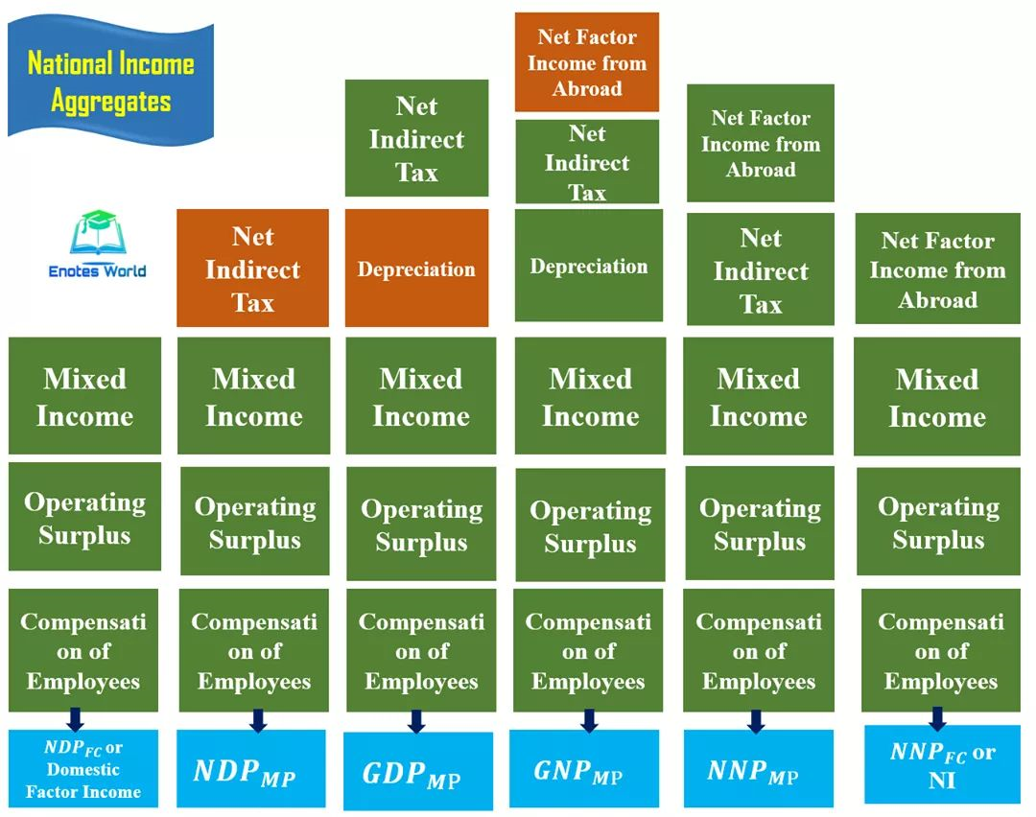

Slide 50
Product method (or inventory approach):
This method is also known as value added method, industrial origin method, or net output method.
This method measures the contribution of each producing enterprise to production in the domestic territory of the country in an accounting year.
In this method GDP is measured in the form of total product obtain from the value of each goods and services of each economic sector.
Only final goods and services are included and intermediary goods and services are left out.
Final goods are those goods which are purchased for final use and not for sale or further processing.
Intermediate goods are those which are used up in the production of other goods and services in the same period that they themselves were produced

Slide 51
Components of product method:
Primary sector
Secondary sector
Tertiary sector
Net factor income from abroad
Problem of double counting: it is the problem of estimating the value of goods and services more than once. While calculating national income with this method, the value only of final goods and services is taken into consideration, if the value of intermediate goods is calculated, the problem of double counting will come up. Double counting, thus leads to overestimation of national income. To avoid the problem two methods are used.

Slide 52
1. Final product method: in this method, GDP is estimated by findings the market value of final goods and services produced in the economy on a given period. According to this method, the value of intermediate goods is deducted from the value of output.
GDP_{MP} = value of output – cost of intermediate goods
Or GDP_{MP} =(P_{X}Q_{X}+P_{Y}Q_{Y}+…… + P_{N} Q_{N}) – (C_{X} + C_{Y} +……..+ C_{N} )
2. Value added method: under this method, the value added or created at different stages of production is counted for estimating GDP_{MP.} According to this method, GDP_{MP} is the sum total of the value added by different producing units in their production process. Value added means the addition of value of raw materials and other inputs in the process of production.
Net value added= gross value added – cost of intermediate goods
Goss value added = NVA_{X} + NVA_{Y} +……….+ NVA_{N}

Slide 53
Example of value added method
The value added method avoids the problem of double counting.
Precautions excluded
Sale and purchase of second hand goods
Capital gains obtained from sale and purchases of bonds and shares
Services of housewives
Expenditures on financial assets like share and bonds
All government expenditures on transfer payments
Stage of production | Gross value added (P*Q) | Cost of intermediate goods (c) | Net value added
Wheat | 4000 | 400 | 3600
Flour | 6400 | 4000 | 2400
Bread | 10000 | 6400 | 3600
total | 20400 | 10800 | 9600

Slide 54
Case
 | expenditure (billions) | Receipts (in billion)
 | wheat industry
wages | $80
dividends | $0 | $100
interest | $20
 | flour industry
wages | $60
purchases of wheat | $100 | $220
dividends | $30
interest | $30
 | Bread industry
wages | $120
purchases of flour | $220 | $400
dividends | $60
interest | $0
Suppose that the economy produces three goods: wheat flour and bread. All of the wheat is sold to millers. All of the flour is sold to bakers. Consumers buy the bread from the bakers. The income and expenditure account of each of the three industries are given in the table.
Calculate (nominal ) GDP using the final goods approach
Calculate (nominal ) GDP using the value added approach
Calculate (nominal ) GDP using the income approach
Compare the three answers.

Slide 55
Difficulties in Measurement of National Income
Double counting
Calculation of depreciation
Change in value of money (or price level
Illegal income
Non-availability of reliable data
Choice of method
Non-market activities
Inclusion of services
Unreported income
Intermediate goods

Slide 56
Difficulties of measuring national income in the developing countries
Large non-monetized sector
Illiteracy
Backward people
Lack of occupational specialization
Lack of efficiency and trained manpower

Slide 57
Need or importance of National income accounting
Indicator of economic structure
Indicator of economic welfare and international comparison
Helpful to formulate economic policy and planning
Inflationary and deflationary gap
Basis for budgetary policies
Importance in defense and development
Provision of depreciation
Importance in developing countries
Basis of social accounting
Importance in economic analysis

